Slide 1

IBM Cloud Paks in Action
Parker Behseta
Cloud Architect

Slide 2
IBM Cloud Journey
Hybrid Multi-cloud architecture
Modernization challenges
Hybrid use cases
IBM and Redhat: Best of two worlds
Key differentiators

Slide 3


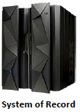
Hybrid Multi-Cloud
Azure
AWS
Ground GA
Service now
Secure Channel
IBM
APIs
Satellite GA
On-Premises

Slide 6
Use Cases for a holistic end-to-end cloud transformation
Applications:
Modernization
Develop cloud native apps with integrated Dev/Sec/Ops
Integration:
Cloud and SaaS integration
Real time events
Secure API
Multicloud Management:
Dynamic monitoring and problem resolution
Secure deployment and operation management
Data:
Self service analytics for all connected data
Operational AI
Real time application support with AIOps
Automation:
Employee productivity with automated tasks
Customer facing processes
Optimize business processes
Security:
Security data sources connectivity
Threat identification
Security incidents and automated response

Slide 11
Key differentiators
No Vendor Lock-in
Breaking Down the Silos
AI Enabled Hybrid Cloud Management
Certified Containerized Software
Professional deployment and support services

Slide 12

Key ingredients
Build once,
Deploy anywhere.
Innovate anywhere,
with anyone’s technology.
Move freely
optimize for cost savings.
Hybrid Multicloud Platform
Leading Capabilities
Application | Data | Integration | Management | Automation | Security
Modernized or Cloud
Build for Cloud
Foundation
Linux | Containers | Common Services | Multi-cluster Management
Infrastructure
IBM public cloud
AWS
Azure
Google Cloud
Edge
Private
Systems

Slide 13
true value of cloud paks
What are cloud paks?
What is special about cloud paks?
How are they different from traditional IBM Software?
How they work together to solve complex business problems?
How they simplify development of new solutions?
What is their real value?

Slide 14

Cloud Paks – Enterprise-ready cloud software
A faster, more secure way to move your core business applications to any cloud
through enterprise-ready containerized software solutions
Complete yet simple Application, data and AI services, fully modular and easy to consume
IBM certified Full software stack support, and ongoing security, compliance and version compatibility
Run anywhere On-premises, on private and public clouds, and in pre-integrated systems
IBM containerized software
Packaged with Open Source components, pre-integrated with the common operational services, and secure by design
Container platform and operational services Logging, monitoring, security, identity access management

Slide 15


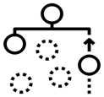













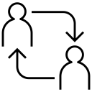




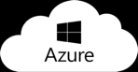


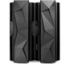
Cloud Paks – Pre-integrated for cloud use cases
Today, IBM offers clients the first six Cloud Paks…
Cloud Pak for Applications
Cloud Pak for
Data
Cloud Pak for Integration
Cloud Pak for Automation
Cloud Pak for Multicloud Management
Cloud Pak for Security
Developer & DevOps Tools
Modernization
Toolkit
Organize
Analyze
API Lifecycle
Messaging
and Events
Content
Operational
Intelligence
Multicluster
App and Infrastructure
Federated
Search and Investigation
Incident Response
Frameworks and Runtimes
Collect
App and Data Integration
Workflow and Decisions
Security and Compliance Management
Security Orchestration and Automation
Container platform and operational services
Container platform and operational services
Container platform and operational services
Container platform and operational services
Container platform and operational services
Container platform and operational services
AWS
Microsoft Azure
Google Cloud
IBM Cloud
Edge
Private
Systems
15

Slide 16
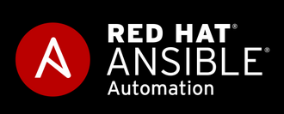

IBM Cloud Paks
Enterprise-ready cloud software, on Red Hat Openshift Container Platform
Cloud Pak for
Multicloud Management
Multicloud visibility, governance, and automation
IBM Cloud App Management
IBM Cloud Automation Manager
IBM Cloud Event Management
IBM Multicloud Manager
Red Hat Ansible and CloudForms
Cloud Pak for Applications
Cloud Pak for
Data
Cloud Pak for
Integration
Cloud Pak for
Automation
Cloud Pak for
Security
IBM Application Navigator
IBM Cloud Transformation Advisor
IBM WebSphere Liberty
IBM WebSphere Application Server
IBM runtimes
RedHat Runtimes
RedHat OpenShift
Node.js
Open Liberty
JBoss
Spring
IBM Data Virtualization
IBM Cognos Dashboard
IBM Db2 Warehouse
IBM Streams
IBM Unified Governance
IBM Watson Machine Learning
IBM Watson Studio
Python
RStudio
Spark
IBM API Connect
IBM App Connect Enterprise
IBM Aspera
IBM Event Streams
IBM Integration Navigator
IBM Integration Asset Repository
IBM DataPower
IBM MQ for Cloud Integration
IBM Automation Content Analyzer
IBM Business Automation Insights
IBM Business Automation Navigator
IBM Business Automation Workflow
IBM FileNet Content Manager
IBM Operational Decision Manager
Data Explorer
Federated Search and Investigation
Incident Response
Container platform and operational services
Container platform and operational services
Container platform and operational services
Container platform and operational services
Container platform and operational services

Slide 17
IBM Cloud Paks – Common Services (using OCP 4.2)
Web Terminal [KUI]
CLI [cloudctl]
Metering [License Advisor]
Multi Tenancy / Account Quota
Certificate management
Auditing
Cloud Pak Services
Cloud Pak Console
App Catalog [Helm]
Logging
[ELK]
Monitoring [Prometheus / Grafana]
Multi cluster services
Cluster Health
IAM / RBAC / Authentication
OpenShift
Services
OCP Console
App Catalog [Ansible Service Broker]
Logging [EFD]
Monitoring
[Prometheus / Grafana]
Istio
Image Registry [Quay light]
Router
Kubernetes
API server
Kubernetes
scheduler
Kubernetes
proxy
Kubernetes
ingress
kubelet
etcd
Kubernetes
HA Infra
Bastion node (1)
Masters (1/3/5)
Virtual IP
Infra (2/n)
Virtual IP
Workers (2/n)
Persistent Storage
Masters (1/3/5)
Virtual IP
Infra (2/n)
Virtual IP
Workers (2/n)
Persistent Storage
Infrastructure
Masters (3/5)
Virtual IP
Infra (2/n)
Virtual IP
Workers (2/n)
Persistent Storage
Network Mesh with support for tenant isolation - Calico
IBM Cloud / March 2020 / © 2020 IBM Corporation

Slide 18
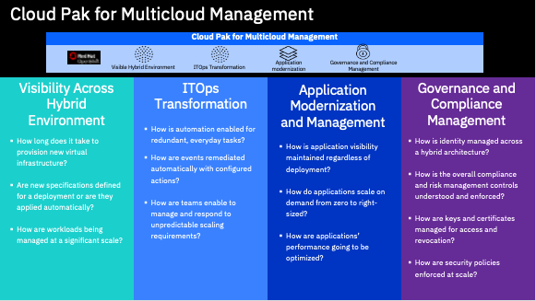
Notes:
So how do these entry points manifest themselves? What are some questions to ask our clients?
- How long does it take to provision new infrastructure?
- How are events and remidated? Is it done automatically?
- How are applcations made visibile? HOw is performance of applciations monitored? Throutgh a traditional process or through a unified solution?
- How are security and governance policies enforced at scale?

Slide 19
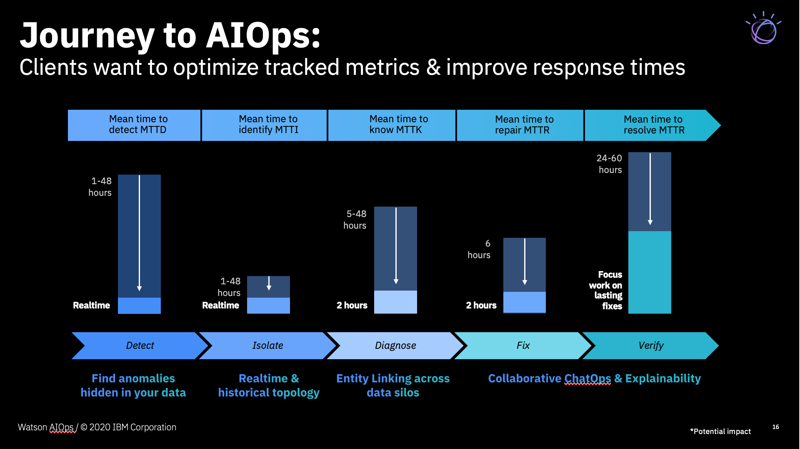

Slide 20
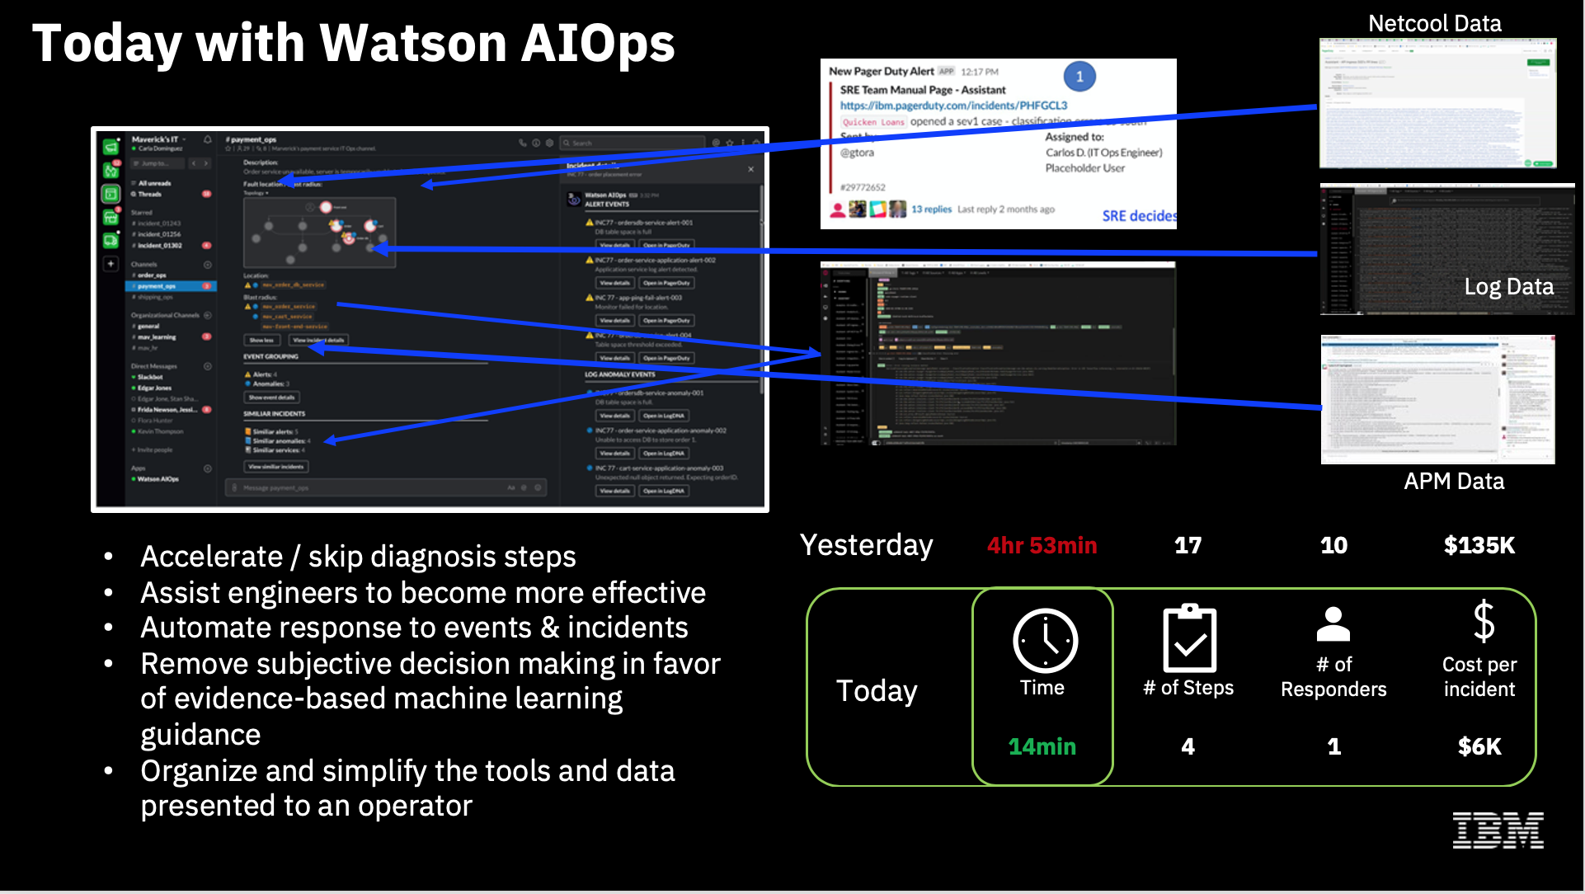

Slide 22
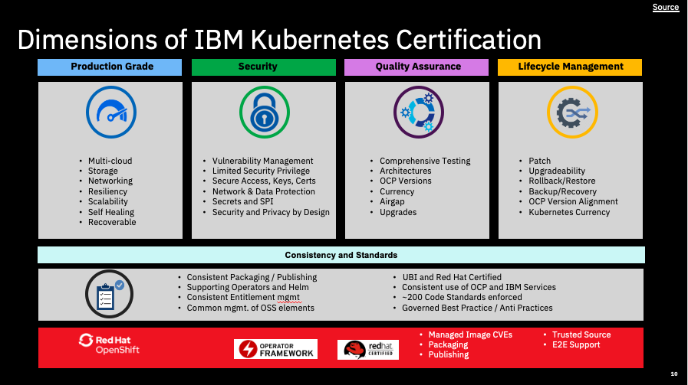

Slide 25
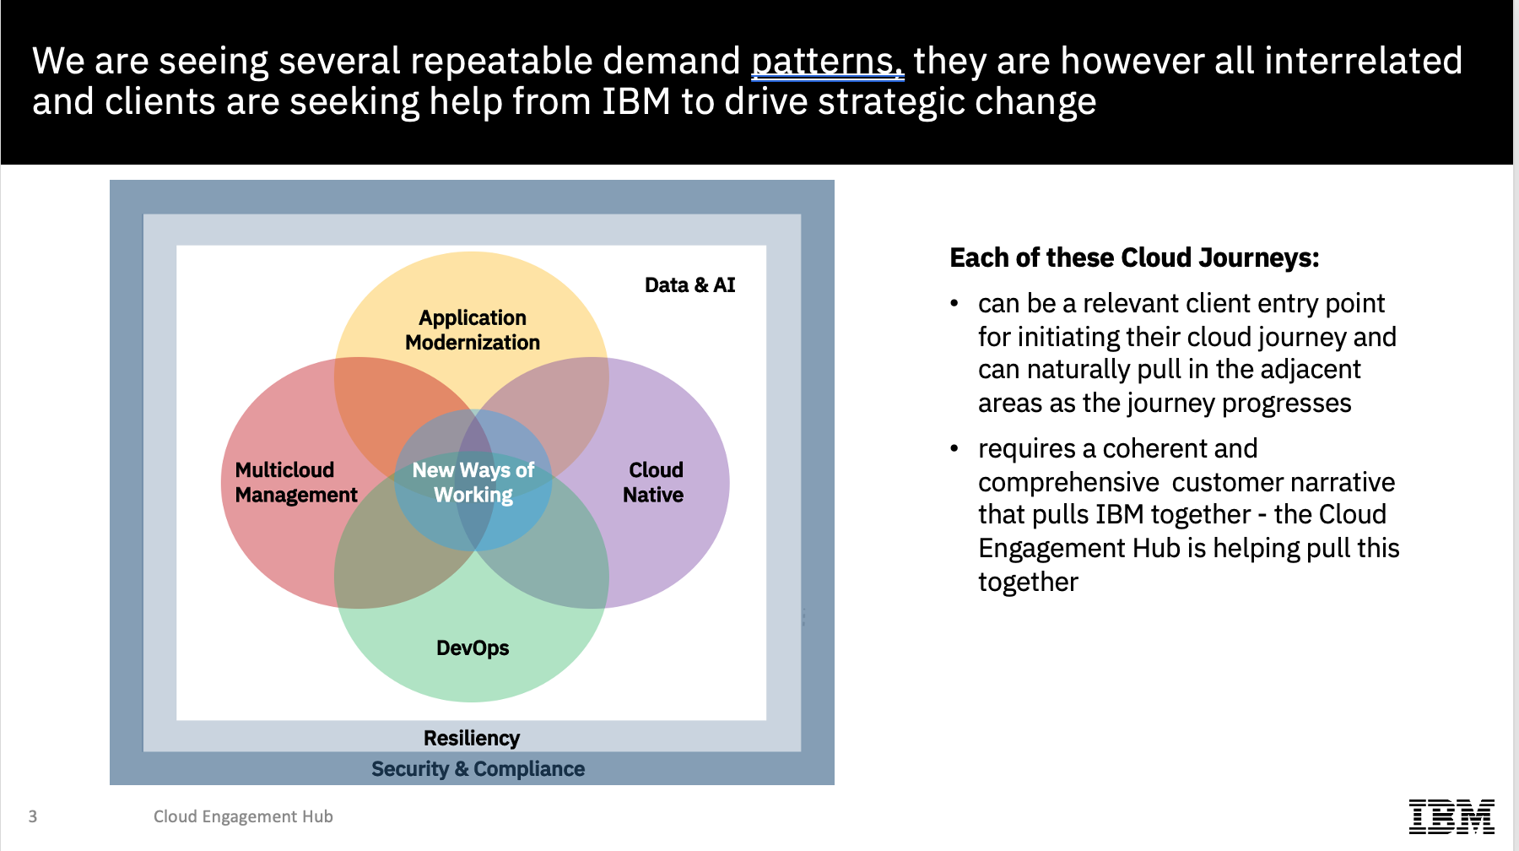

Slide 26

Legacy Integration
Azure
AWS
Ground GA
Service now
DP
ICP4i
DP
MQ
ICP4i
Aspera
Secure Channel
DP
ACE
AIOPs
Aspera
APIC
MCM
Satellite GA
On-Premises
http
MQ

Slide 27

Application Modernization
Azure
AWS
Ground GA
Spatial GA
Service now
ACE
DP
ICP4i
DP
MQ
ICP4i
Aspera
Secure Channel
DP
AIOPs
Aspera
APIC
Transformation Advisor
Satellite GA
MCM
On-Premises
http
MQ
Notes:
WAS ND > WAS Standard

Slide 28
Cloud Native Development and Microservices
Azure
AWS
Ground GA
ICP4i
Spatial GA
Service now
ACE
DP
Event Streams
DP
MQ
Impact MS
ICP4i
Aspera
Secure Channel
DP
DevSecOps
AIOPs
Aspera
APIC
Satellite GA
MCM
http
MQ

Slide 29
Cloud Migration and FINOPs
IKS
AWS
Aspera
Azure
Service now
Service now
DP
MQ
Ground GA
DP
MQ
ICP4i
ICP4i
DP
ICP4i
Secure Channel
Aspera
Placement Policy
Placement Policy
DP
AIOPs
Aspera
DevSecOps
APIC
Satellite GA
MCM
On-Premises
http
MQ

